Slide 1

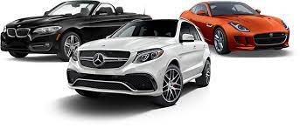

SQL Project on Multi-Brand Car Dataset
By-
Phanindra Bhushan Chaturvedi & Ankit Yadav

Slide 2




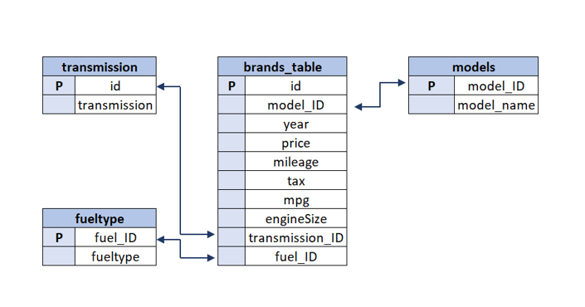
Schema Of Dataset - (An Overview)

Slide 3
ABOUT THE PROJECT
You are working as an analyst for a Car brand. The brand wants to launch one(or multiple types) car. You are given the post-purchase data for various Car brands and their models and have been asked to create a detailed analysis using the given data:
Note: Use your creativity to get interesting insights from the data. Use Excel only for reporting and presentation. Rest all the points to analysis using SQL only.
Create an analysis to find the income class of UK citizens based on the price of Cars(You can use per-capita income in the UK from internet sources)
Categorize the cars on the basis of their price(Create as many buckets as you want as per your understanding of data) and analyze the:
(a.)price changes across the years and identifies the categories which have seen a significant jump in their price
(b.) changes in the number of cars sold across the years and identify the categories which have seen a significant jump in their sales

Slide 4
About project-(part-2)
Using the above-identified categories for both points (a) & (b), do a root cause analysis to identify the probable reason for their increase.
For, e.g., Its fuel efficiency as compared to other types of cars could be a reason.
3.Find relationship between fuel efficiency & price of car/sales of car/fuel type/, etc.
4.Create an analysis to show the effect of fuel expenditure on the sales of car over the years(Get the fuel prices in the UK through the years through internet sources)
Using all of the above analysis, suggest cost and usage effective car types for the brand to launch(We can launch multiple types of car as well)
You are also asked to rank across all the models based on their total sales, average price, average mileage, average engine size, etc. and now filter the top 5 basis their sales. Observe the identified models and provide your inference.
Make a Dynamic Excel Dashboard from your findings, plot graphs & create multiple tabs as needed, be as creative as you can.

Slide 5
About Dataset -
We are having total 8 Dataset-
1.For car Brand-(5 dataset)
a.)Audi
b.)BMW
c.)Mercedes
d).Hyundai
e.)cclass
2.Car related Dataset-(3 Dataset)
a.)Model
b)Transmission Type
c.)Fuel Type
Our approach with the Dataset-
1.Created a VIEW in SQL to create union of all 5 Brand dataset
2.Two column in cclass were missing (tax & mpg column) so we created two empty Column with same name so as to do Union of dataset
3.Used join operation for joining Rest of the Tables with our View as per requirement

Slide 6
1.Create an analysis to find the income class of UK citizens based on the price of Cars

Slide 7
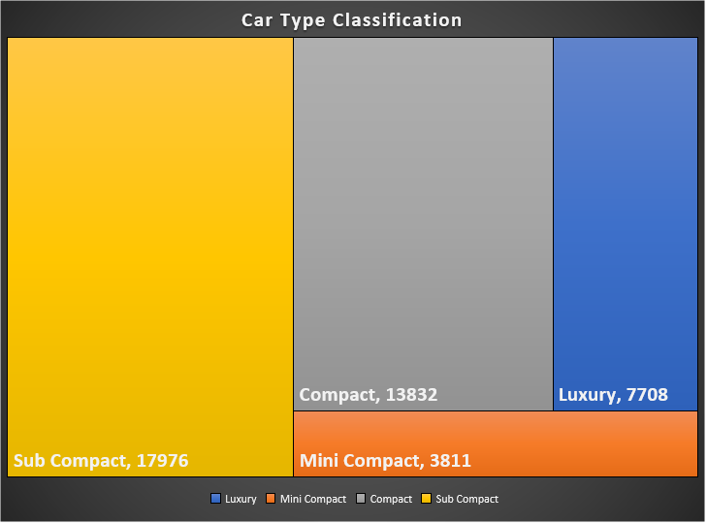
2. Categorize the cars on the basis of their price
Price Range | Type of Car
Below 10000 | Mini Compact
10000-20000 | Sub Compact
20000-30000 | Compact
Above 30000 | Luxury

Slide 8
2.a) Price changes across the years and identifies the categories which have seen a significant jump in their price

Slide 9
2.b.Changes in the number of cars sold across the years

Slide 10
3.Find relationship between fuel efficiency & price of car/sales of car/fuel type/, etc.

Slide 12
Total Sales Vs Miles per Gallon

Slide 13
4.Create an analysis to show the effect of fuel expenditure on the sales of car over the years

Slide 14
5.Rank across all the models based on their total sales, average price, average mileage, average engine size, etc.

Slide 16
Conclusion
If we have to launch a car model, then by analyzing the above data it has been found that there is more demand of C class then A class and 3 series type car models, then this type of car model can be launched and Its consumption is also very high.
Demand of Transmission type Manual is more
Demand of Electric Vehicle has increased
Demand of Small Engine size Car is more as fuel consumption by them is less hence more economical
Demand is rising for car in Price Range of 20000 to 30000

Slide 17
Through Given Post purchase data Of Various Brands we came to conclusion that-
1.We can focus on cclass Brand
2. Transmission type Manual
3. With Electric as Fuel type
4. Price Range of 20000 to 30000

Slide 18
Thank You

